Slide 1

Drug Review Analysis
Batch-7
Project mentor - Mr.Vinod

Slide 2
BUSINESS PROBLEM
•This product could be helpful for companies like 1mg to provide detailed rating of the side effects of the product over their site. It could also be helpful for the patients who are buying drugs online to check the side effects of the drugs before buying it.

Slide 3
BUSINESS OBJECTIVE
•Analysing the ratings and reviews of the drugs and predicting the side effect of the drug

Slide 4
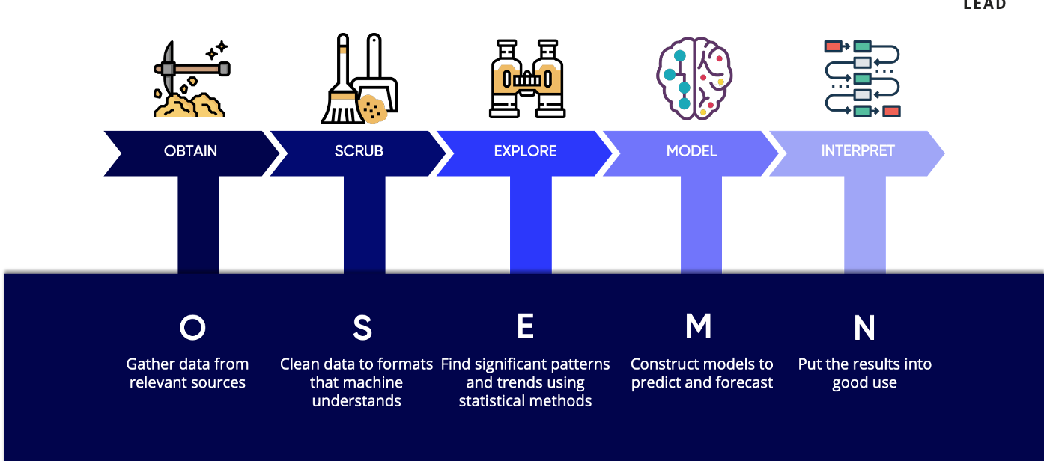
PROJECT WORKFLOW

Slide 5
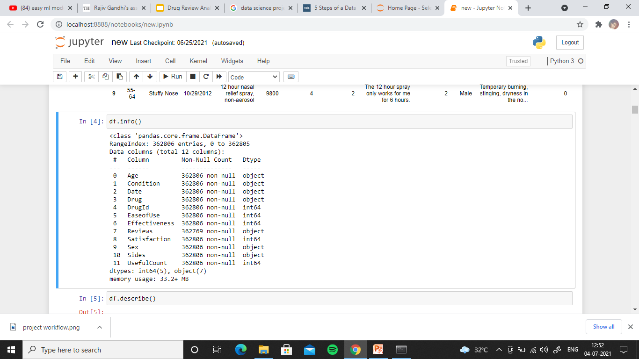
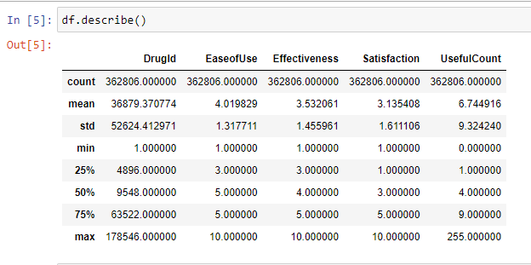
Understanding Dataset

Slide 6
INFERENCES FROM DATASET
➤ There are 362806 entries in the Dataset.
➤ There are 943 Duplicated entries in the Dataset.
➤ There are 12 columns with 5 integer type columns and 7 object type columns.
➤ There are also Null values in the Dataset which is supposed to be treated.
➤ standard deviation of all the data doesn’t have much difference other than computer generated column ‘drugID’.

Slide 7
Details of columns
Age - age of the patient.
Condition - condition undergone by patient that leads him to consume the particular drugs
Date - date of the review.
Drug-Name of the drug.
DrugID-ID of each drugs.
EaseofUse - scale of ease of use of each drug.
Effectiveness - Scale of how effective the drug was.
Reviews - review of patient in words.
Satisfaction - satisfactory rate of the patients.
Sex - gender of the patients.
SIdes - side effects faced by the patients
UsefulCount - scale of useful count of the drug.

Slide 8
MISSING VALUES TREATMENT

Slide 9
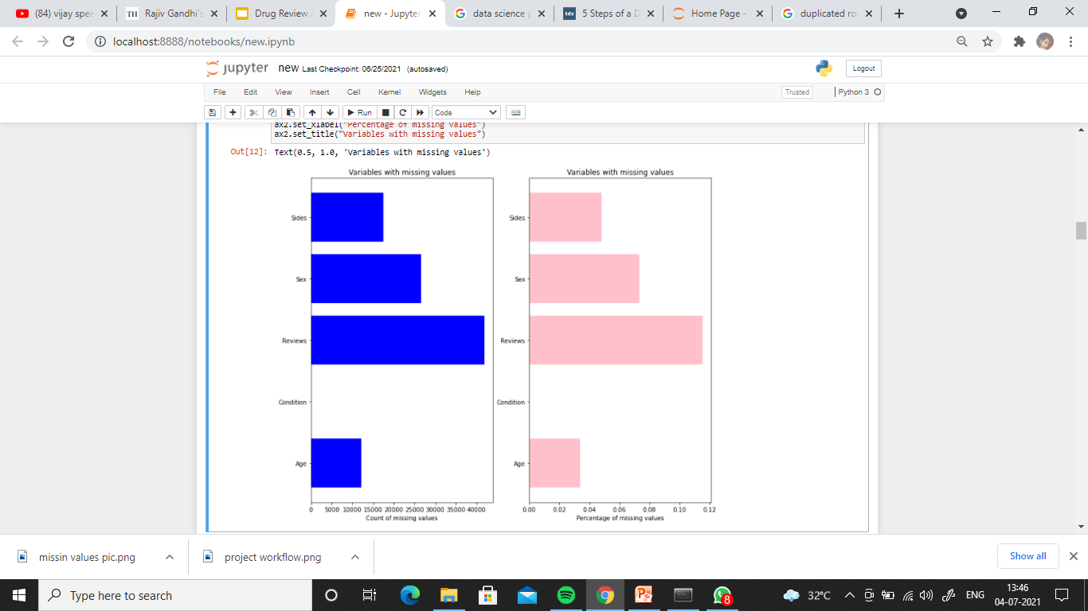
➤ Number of null values in each column and percentage of null values in each column is shown in the chart.
➤ Missing value’s total percentage is very much less, so eliminating the null values does not affect the data explanation.
➤ There are also few values as ‘’ which is actually a null data.so we are eliminating them too.
➤ After eliminating null values we have 280127 rows data.

Slide 10
CORRELATION ANALYSIS

Slide 11
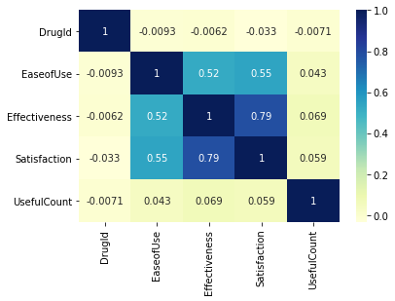
CORRELATION
➤ Ease of use,satisfaction and Effectiveness are 50% correlated with satisfaction and Effectiveness are almost 80% correlated which actually makes sense.

Slide 12
FURTHER EXPLORATION ON DATA

Slide 13
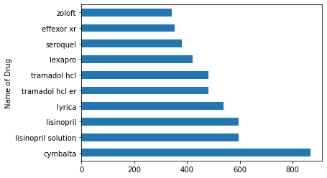
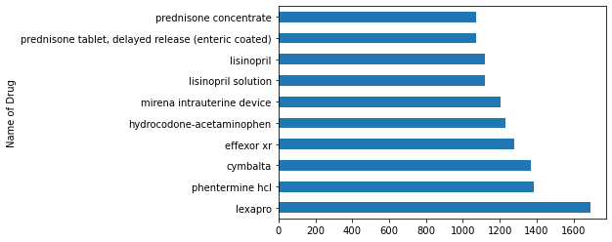
MOST EFFECTIVE LESS EFFECTIVE DRUGS
DRUGS DRUGS

Slide 14
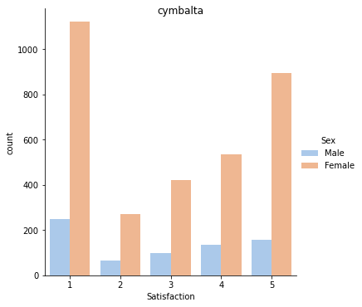
Function that returns satisfaction of the drugs
The drug ‘cymbalta’ is in both the high effective and less effective .this is because male patients are highly satisfied than female and also population of male reviews are more n comparison

Slide 15
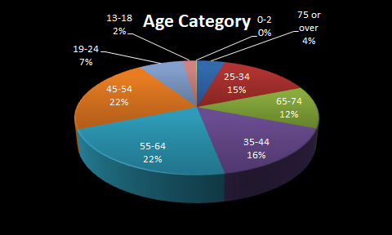

Slide 16
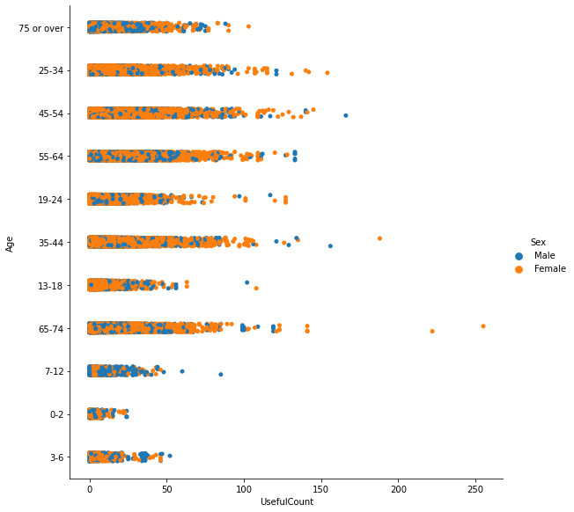
USEFUL COUNT
This plot shows the age group of male and female who finds the drug useful.most of the data lies between 0 and 100.In comparison, more females gives their useful count greater than 100

Slide 17
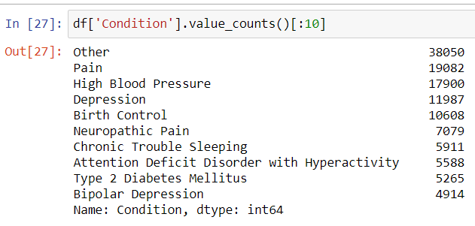
CONDITIONS
These are the top 10 conditions people are going through.Most of the patients using drugs for Birth control , High Blood Pressure and Depression.we can analyze a little deeper into this conditions.

Slide 18
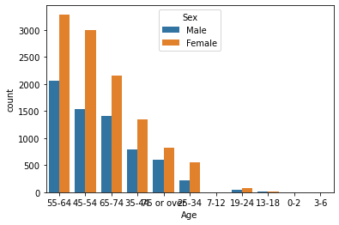
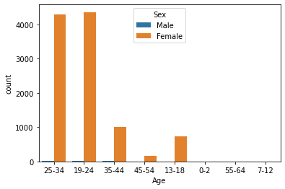
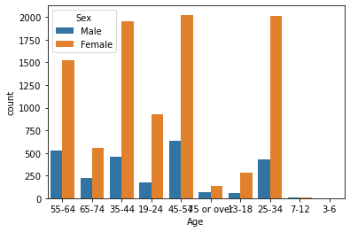
High Blood Pressure
➤ Clearly age group of 45-75 is the suffering from high blood pressure.age group of 13-18 are also undergoing this condition which is a notable thing.
Birth control
➤ As expected female age from 19 to 34 took most number of drugs for birth control.
DEPRESSION
➤ though female group of 25 to 50 goes through lot of depression it is quite common for most age categories

Slide 19
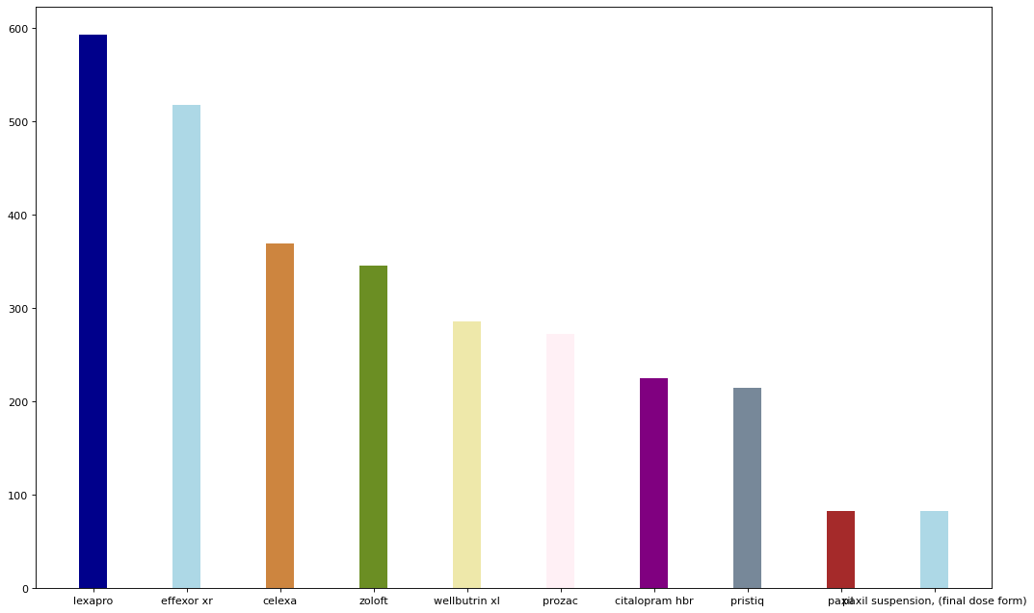
TOP DRUGS USED FOR DEPRESSION

Slide 20
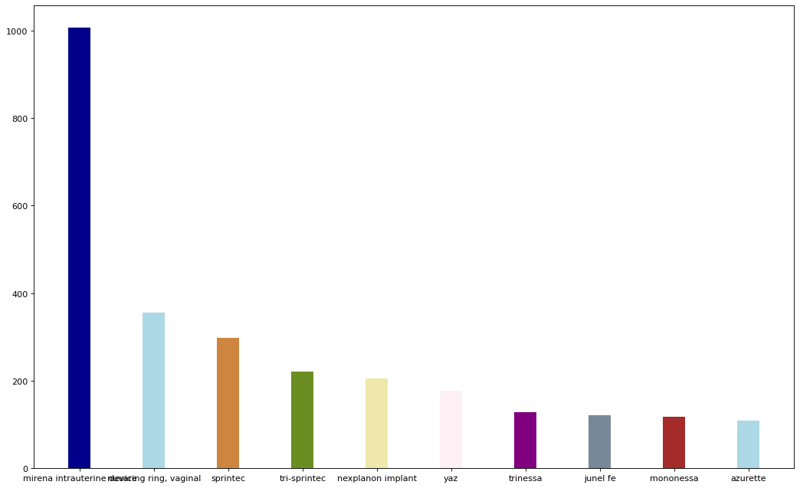
TOP DRUGS TAKEN FOR BIRTH CONTROL

Slide 21
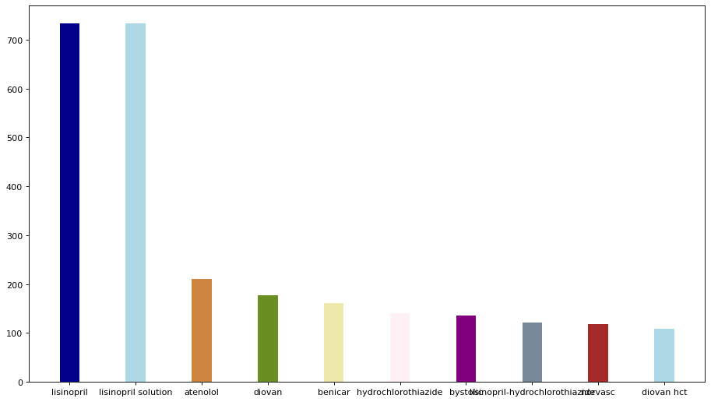
TOP DRUGS TAKEN FOR HIGH BLOOD DEPRESSION

Slide 22
NATURAL LANGUAGE PROCESSING

Slide 23
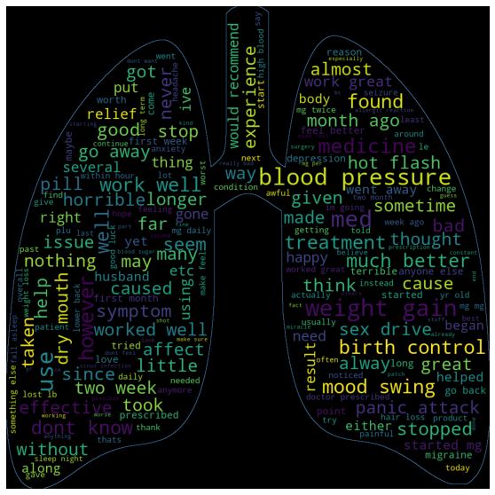
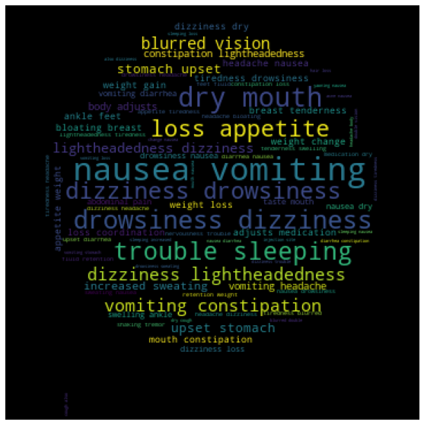
Word cloud of
Reviews Side Effects

Slide 24
PREPROCESSING

Slide 25
Encoding
Age ,condition,drugs,sentiments are our independent variables while emotion is our dependent variable and our target variable is to predict the review is positive,negative and neutral.
Column Age , Condition and drugs are label encoded to feed them into the Machine Learning Algorithm.

Slide 26
Train Test Split
Splitting the data as 70% train data and 30% test data.187436 of train data and 92320 as test data using ‘from sklearn.model_selection import train_test_split’
In [185]:

Slide 27
Fitting model
Building the model with some of the classification machine learning algorithms such as logistic regression,support vector machine and Random forest.

Slide 28
Cross validation
Cross validation score for logistic regression
0.92466421, 0.92580156, 0.92569324, 0.92563908, 0.91209922]
Cross validation score for SVM
[0.47086858, 0.7802931 , 0.82621388, 0.47184987, 0.58593983]
Cross validation score for random forest
[0.6794844 , 0.6929701 , 0.67650563, 0.67720971, 0.67883449]

Slide 29
Model accuracy
Logistic Regression -Test-0.7748050259965338 Train-0.7747177703322734
Random Forest -Test- 0.8219232164578842 ,Train-0.8241009532062392
Support Vector Machine - 0.6688789066688908,Train-0.68663539851048

Slide 30
Deployment
Using streamlit we are creating the web application for users who would like to know about the side effects of the drug they would like to buy or bought.and also using recommendation systems we are recommending the drugs that are related to that particular drug.

Slide 31
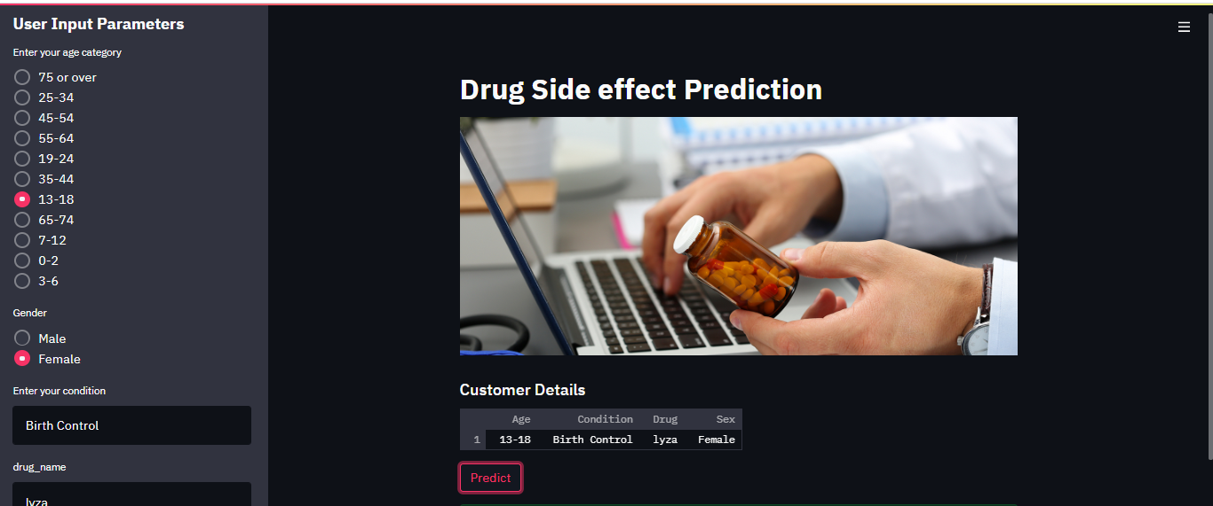
The application looks like

